Slide 1

Chapter 1
Introduction
1.<number>
Copyright © The McGraw-Hill Companies, Inc. Permission required for reproduction or display.
Notes:
1.#

Slide 2
1-1 DATA COMMUNICATIONS
The term telecommunication means communication at a distance. The word data refers to information presented in whatever form is agreed upon by the parties creating and using the data. Data communications are the exchange of data between two devices via some form of transmission medium such as a wire cable.
Topics discussed in this section:
Fundamental Characteristics of data communication
Components of a data communications system
Data Flow
1.<number>
Notes:
1.#

Slide 3
1-1 Fundamental Characteristics of data Communication
Delivery
Accuracy
Timeliness
Jitter
1.<number>
Notes:
1.#

Slide 4

Figure 1.1 Components of a data communication system
1.<number>
Notes:
1.#

Slide 5

Figure 1.2 Data flow (simplex, half-duplex, and full-duplex)
1.<number>
Notes:
1.#

Slide 6
Data Representation
Text
  ASCII
Numbers
Image
  pixel
Audio
  RGB , YCM
Video
1.<number>
Notes:
1.#

Slide 7
1-2 NETWORKS
A network is a set of devices (often referred to as nodes) connected by communication links. A node can be a computer, printer, or any other device capable of sending and/or receiving data generated by other nodes on the network. A link can be a cable, air, optical fiber, or any medium which can transport a signal carrying information.
Topics discussed in this section:
Network Criteria
Physical Structures
Categories of Networks
1.<number>
Notes:
1.#

Slide 8
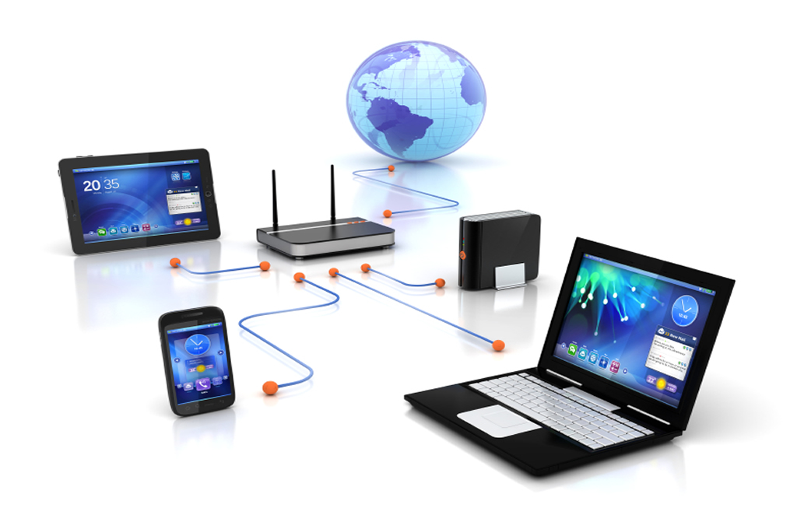
Computer Network
1.<number>
Notes:
1.#

Slide 9
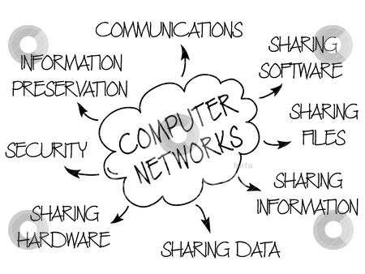
Application of Networks
Business Applications of Networks
Resource sharing in bank, finance, manufacturing plant, travel agency
E-mail
Video conferencing
Online shopping
Goods and services online “e-commerece”
Home Network Applications
Access to remote information
  Surfing
  Online newspaper, digital library..etc..
Person-to-person communication
  Instant messaging, chatrooms, group communication
Interactive entertainment
Electronic commerce
Distributed Processing
1.<number>

Slide 10
Network Criteria
Performance
  Depends on Network Elements
  Transit time and response time
  Measured in terms of Delay and Throughput(contradictory)
Reliability
  Failure rate of network components
  Measured in terms of availability/robustness
Security
  Data protection against corruption/loss of data due to:
      Errors
      Malicious users
1.<number>
Notes:
1.#

Slide 11
_x0010_Physical Structures
Type of Connection
  Point to Point - single transmitter and receiver
  Multipoint - multiple recipients of single transmission
Physical Topology
  Connection of devices
  Type of transmission - unicast, multicast, broadcast
1.<number>
Notes:
1.#

Slide 12

Types of connections: point-to-point and multipoint
1.<number>
Notes:
1.#

Slide 13

Topology
  It refers to way in which a network is laid out physically
1.<number>
Notes:
1.#

Slide 14

MASH Topology
Every device has a dedicated point to point link to every other device.
n(n-1) connection for unidirectional
n(n-1)/2 no of connection for bidirectional
Advantages:
Guarantees that each connection can carry its own data load, eliminates traffic problem.
Robust
Privacy and security
Fault identification and isolation easy
Disadvantages:
Amount of cabling and space requirement
Expensive
1.<number>
Notes:
1.#

Slide 15

Star topology
Each device has a dedicated point to point link to a central control device.
Does not allow direct traffic between devices
The controller acts as an exchange
Advantages:
Less expensive compare to mesh
Easy installation and reconfigure.
Robustness, if one link fails, only that link is affected . All other remain active
Disadvantages:
Single point failure( Hub), whole system is dead
1.<number>
Notes:
1.#

Slide 16

Bus Topology
One long cable acts as Backbone to link all the device in network
Nodes are connected to the bus cable by Taps and Drop lines
Limits the number of Tabs in cable
Advantages:
Easy installation.
Less cabling then Ring and Mesh topologies.
Disadvantages:
Difficult reconnection and fault isolation
Difficult to add new device
Signal reflection at the tab can cause degradation in quality
1.<number>
Notes:
1.#

Slide 17

Ring topology
Advantages:
Easy to install and reconfigure.
To add and delete a device requires changing only two connection
Disadvantages:
Unidirectional traffic
A break in ring (such as a disabled station) can disable the entire network
1.<number>
Notes:
1.#

Slide 18

hybrid topology: a star backbone with three bus networks
1.<number>
Notes:
1.#

Slide 19
_x0010_Categories of Networks
Local Area Networks (LANs)
  Short distances
  Designed to provide local interconnectivity
Wide Area Networks (WANs)
  Long distances
  Provide connectivity over large areas
Metropolitan Area Networks (MANs)
  Provide connectivity over areas such as a city, a campus
1.<number>
Notes:
1.#

Slide 20

Figure 1.10 An isolated LAN connecting 12 computers to a hub in a closet
1.<number>
Notes:
1.#

Slide 21

Figure 1.11 WANs: a switched WAN and a point-to-point WAN
1.<number>
Notes:
1.#

Slide 22

Figure 1.12 A heterogeneous network made of four WANs and two LANs
1.<number>
Notes:
1.#

Slide 23
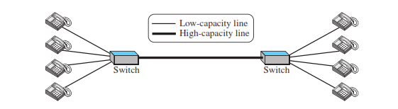
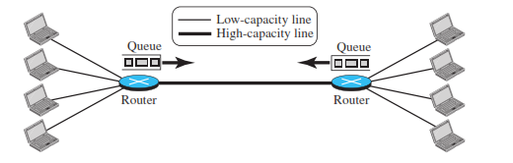
Switching
An Internet is a Switched networking in which a switch connects at least two links together.
A Switch needs to forward data from a network to another network when required.
Circuit-switched and Packet-switched networks
1.<number>
Notes:
1.#

Slide 24
1-3 THE INTERNET
The Internet has revolutionized many aspects of our daily lives. It has affected the way we do business as well as the way we spend our leisure time. The Internet is a communication system that has brought a wealth of information to our fingertips and organized it for our use.
Topics discussed in this section:
Organization of the Internet
Internet Service Providers (ISPs)
1.<number>
Notes:
1.#

Slide 25

Figure 1.13 Hierarchical organization of the Internet
1.<number>
Notes:
1.#

Slide 26
1-4 PROTOCOLS
A protocol is synonymous with rule. It consists of a set of rules that govern data communications. It determines what is communicated, how it is communicated and when it is communicated. The key elements of a protocol are syntax, semantics and timing
Topics discussed in this section:
Syntax
Semantics
Timing
1.<number>
Notes:
1.#

Slide 27
_x0010_Elements of a Protocol
Syntax
  Structure or format of the data
  Indicates how to read the bits - field delineation
Semantics
  Interprets the meaning of the bits
  Knows which fields define what action
Timing
  When data should be sent and what
  Speed at which data should be sent or speed at which it is being received.
1.<number>
Notes:
1.#

Slide 28
_x0010_Standards
Standards are guaranteeing national and international interoperability of data and telecommunications technology and processes
Its provide guidelines to manufacturers, vendors, government agencies.
Data Communication standards fall into two categories : de facto ( “by fact” or “by convention” )and de jure ( “by low” or “by regulation”)
Standards Organizations
  International Organization for Standardization(ISO)
  International Telecommunication Union - Telecommunication standards Sector(ITU-T)
  Consultative Committee for International Telegraphy and Telephony(CCITT)
  American National Standards Institute (ANSI)
  Institute of Electrical and Electronics Engineers (IEEE)
  Electronic Industries Association (EIA)
1.<number>
Notes:
1.#

